Slide 1
Set Theory, Relations & Functions

Slide 2
A set is a collection of objects which are called the members or elements of that set. If we have a set we say that some objects belong (or do not belong) to this set, are (or are not) in the set. We say also that sets consist of their elements.
Examples: the set of students in this room; the English alphabet may be viewed as the set of letters of the English language;

Slide 3
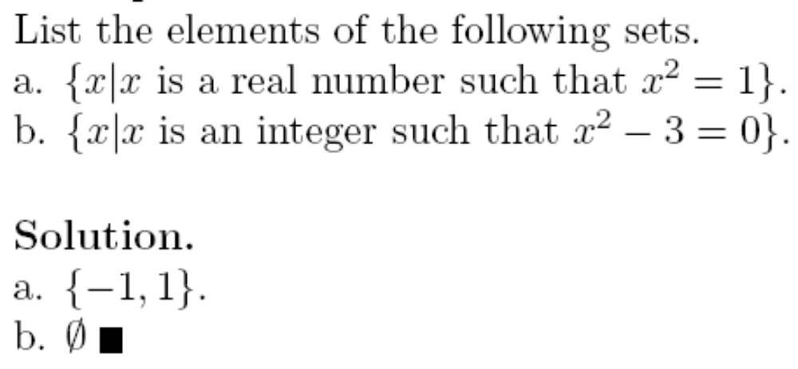
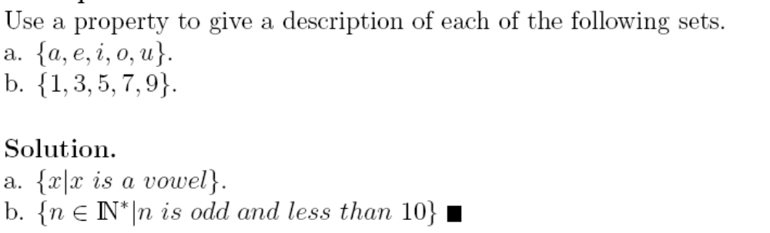
Example 1
Example 2

Slide 4
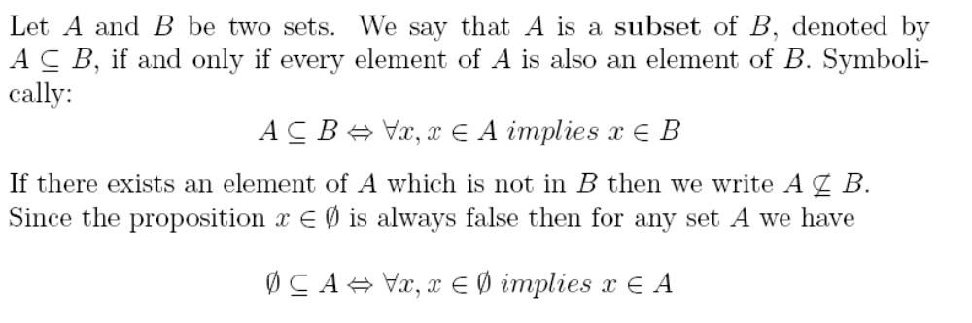
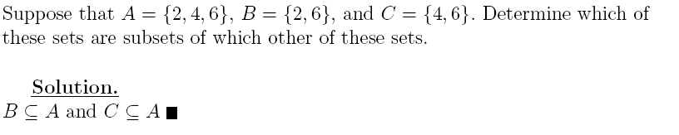
Example 3

Slide 5
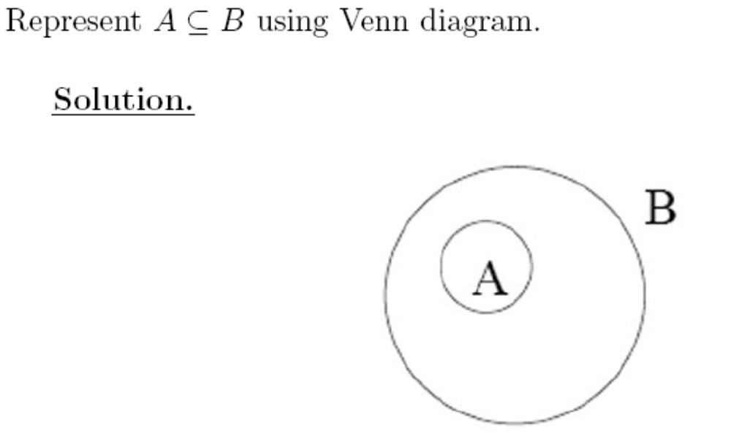
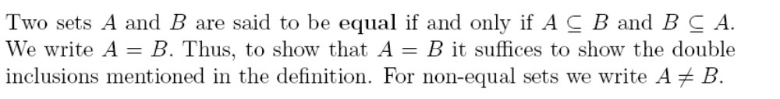
Example 4

Slide 6
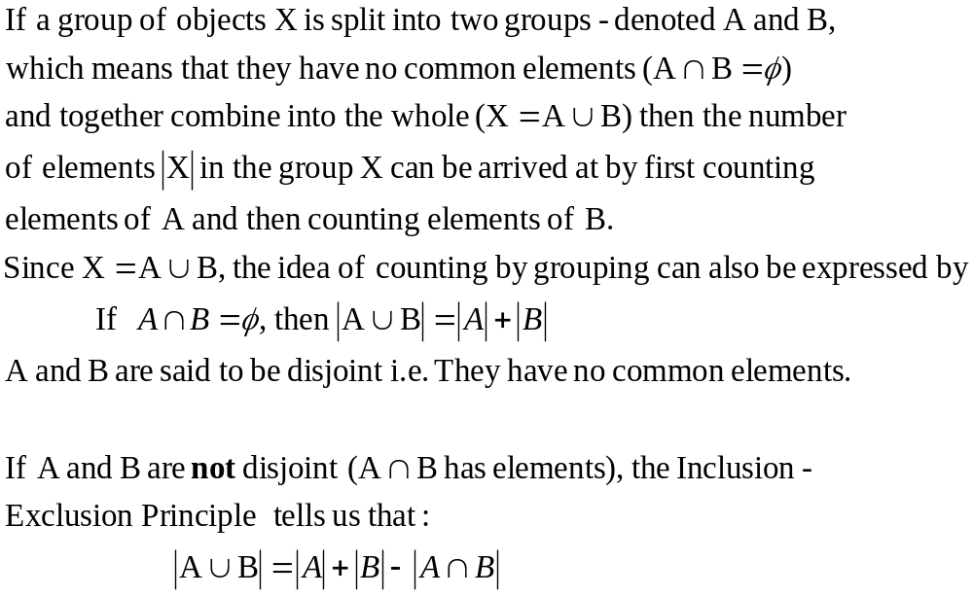

Slide 7
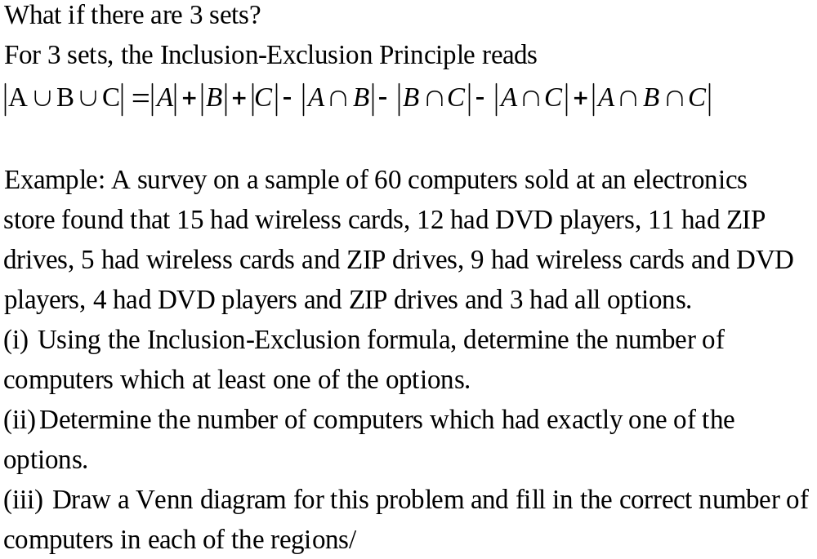

Slide 8
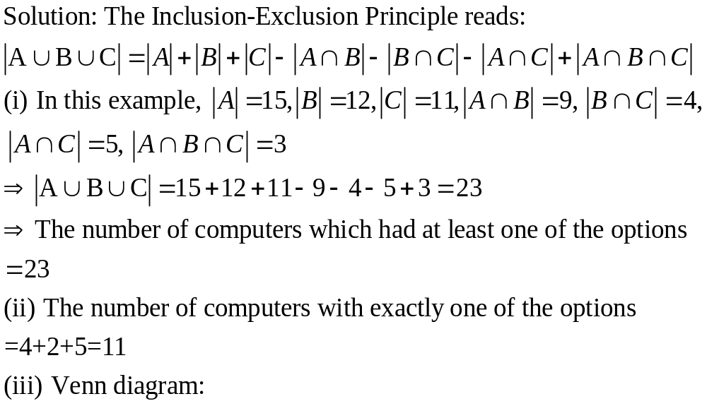

Slide 9
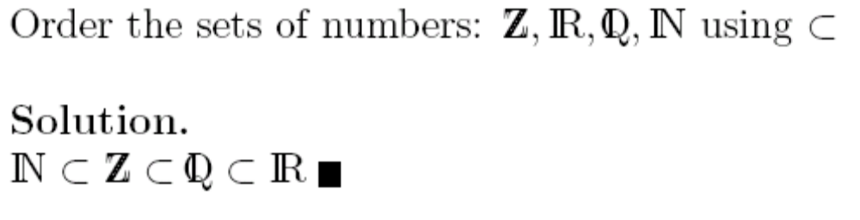
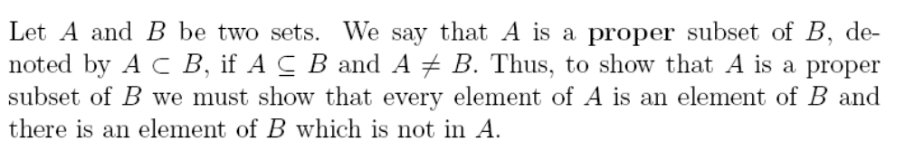
Example 5

Slide 10
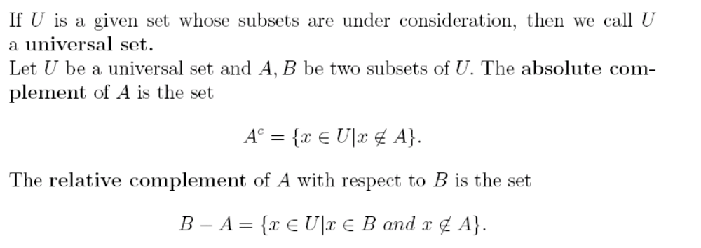

Slide 11
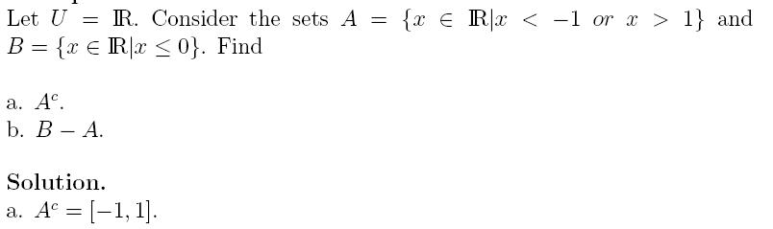

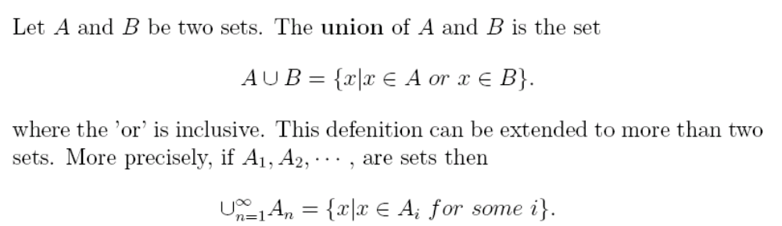
Example 8

Slide 12
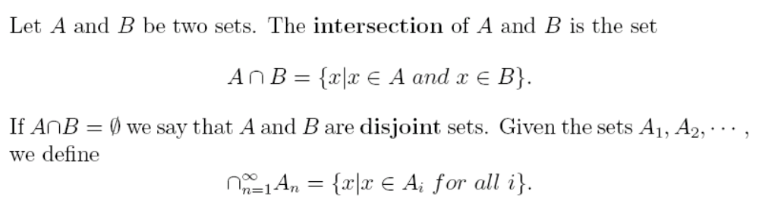
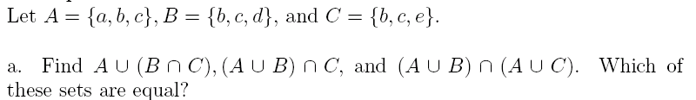
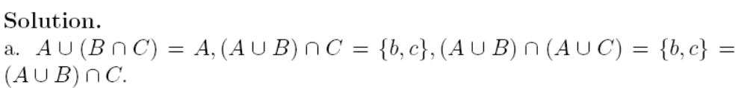
Example 9

Slide 13
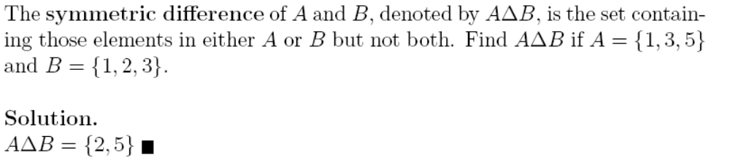
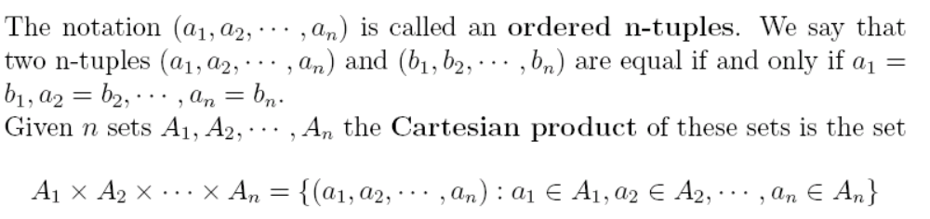
Example 10

Slide 14
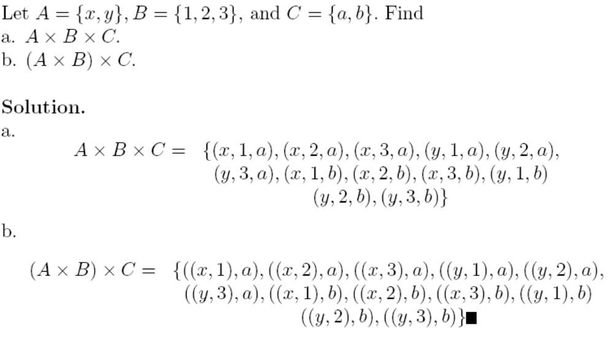
Example 11

Slide 15
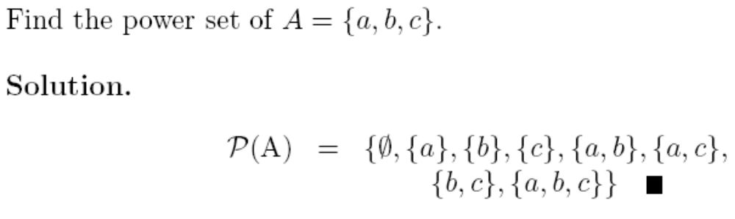
Example 16

Slide 16
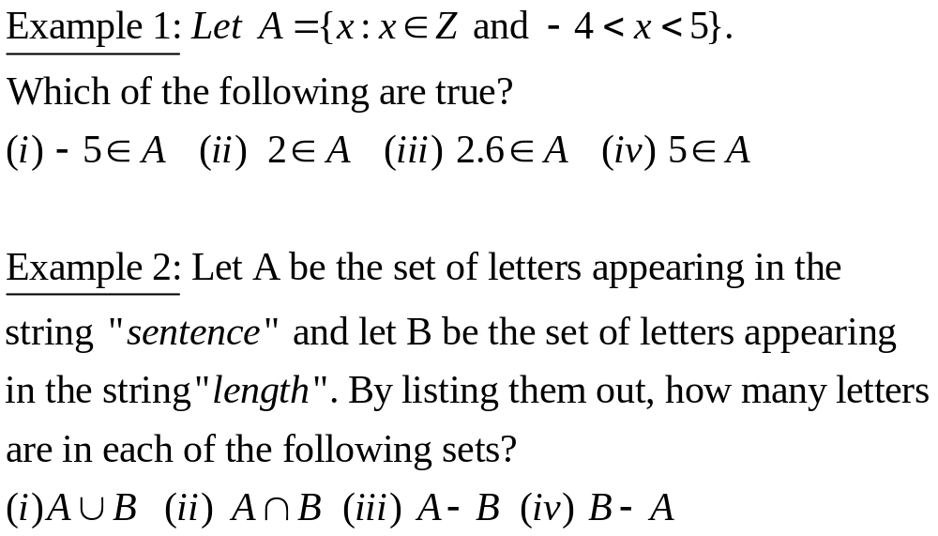

Slide 17
Computer Representation of Sets
There are many ways to represent sets using a computer. Usually it is less work with ordered sets (set operations are less time consuming).
We will study one of the methods that allows us to store elements using an arbitrary ordering of the elements of the universal set.
Let's assume that set U is a finite and of reasonable size.

Slide 18
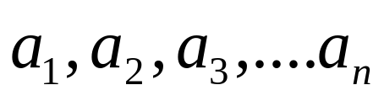
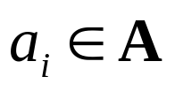
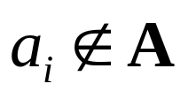
First, we'll specify an arbitrary ordering of elements of U, for instance
Then, we'll represent a subset A of U with the bit string of length n, where
the ith bit in this string is:
1, if and
0, if .

Slide 19

Example:
Let U = {0,1,2,3,4,5,6}. Represent sets with bit strings.
a) A = {2,4,5,6}
b) B is the set of all odd integers, B U
c) C is a subset of U, containing all integers greater than 4.

Slide 20
Solution
a) A = {2,4,5,6}
bit string: 0010111 001 0111
b) B is the set of all odd integers, B U
B = {1,3,5}, therefore the bit string is
010 1010
c) C is a subset of U, containing all integers greater than 4.
C = {5,6}, therefore the bit string is 000 0011

Slide 21



Using bit strings to represent sets, it is easy to find complements of sets, unions, intersections, and differences of sets.
Example:
Let U = {0,1,2,3,4,5,6,7}, A = {1,3,5,6,7}, B = {0,1,2,3,4,5}.
Use bit strings to find
Solutions:
The bit string for A: 0101 0111, then
(therefore )

Slide 22
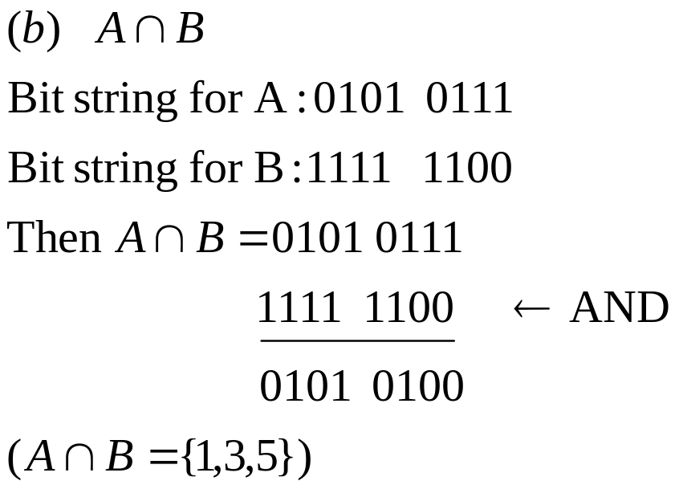
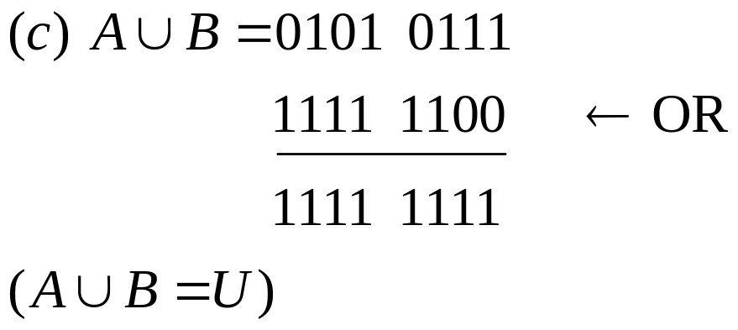

Slide 23

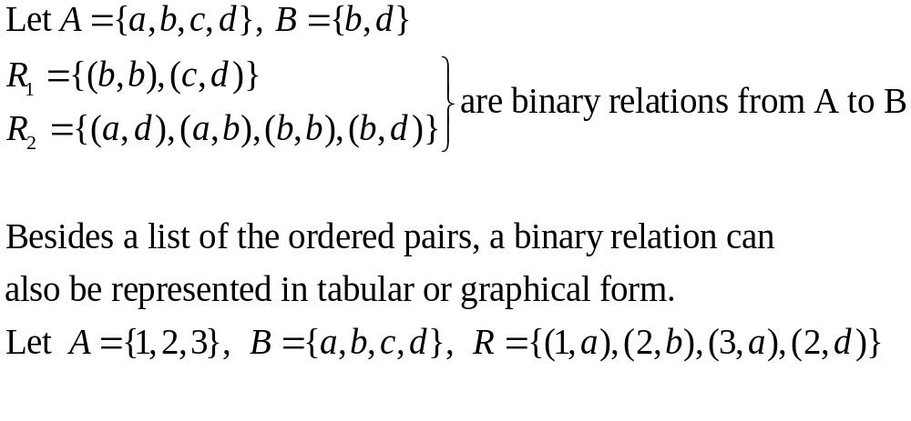
Relations
A binary relation from A to B is a subset of the Cartesian product
Example:

Slide 24
 | a | b | c | d
1 | x
2 |  | x |  | x
3 | x
Rows correspond to the elements of A, columns correspond to the elements of B, an ‘x’ in a cell means the cell is related to R.

Slide 25
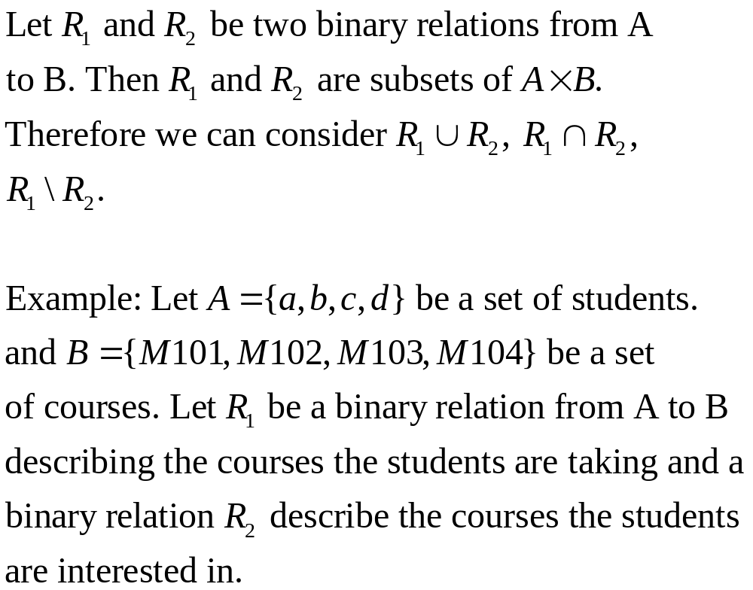

Slide 26


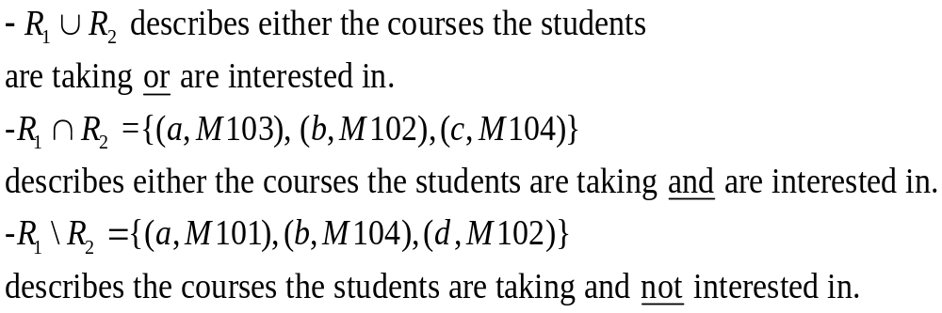
 | M101 | M102 | M103 | M104
a | x |  | X
b |  | x |  | x
c | x |  |  | x
d |  | x
 | M101 | M102 | M103 | M104
a |  | x | x
b |  | x | x
c | x | x |  | x
d |  |  |  | x

Slide 27
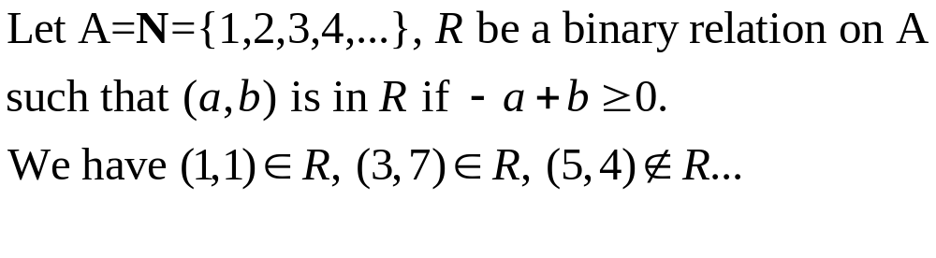
A binary relation from A to A is called a binary relation on A.
Example:

Slide 28
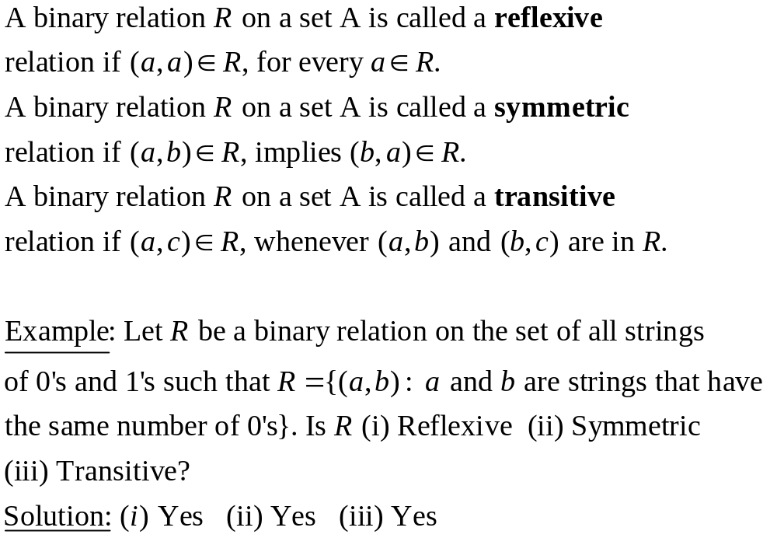

Slide 29
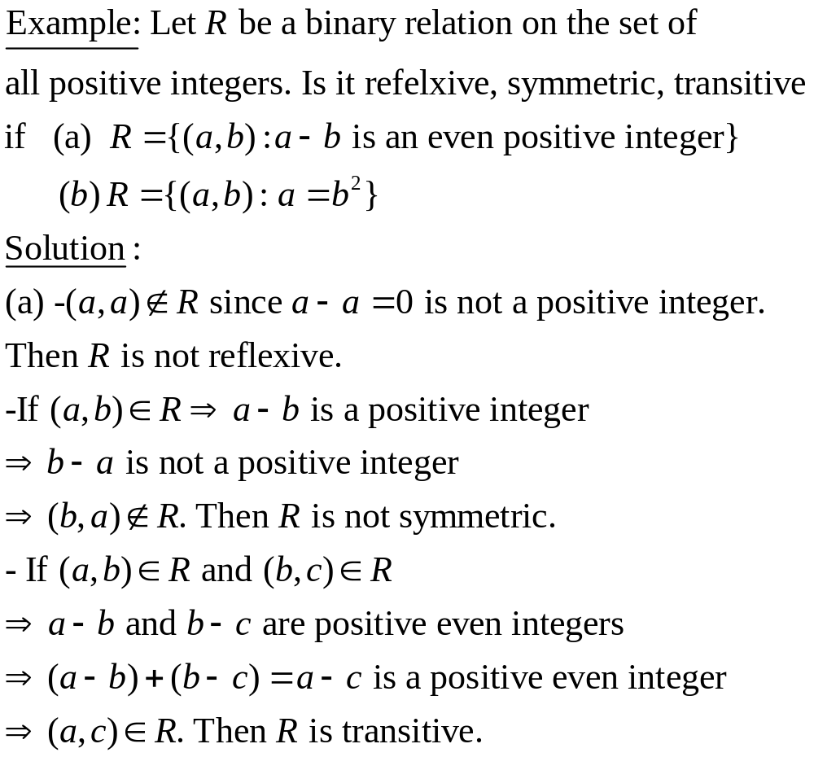

Slide 30
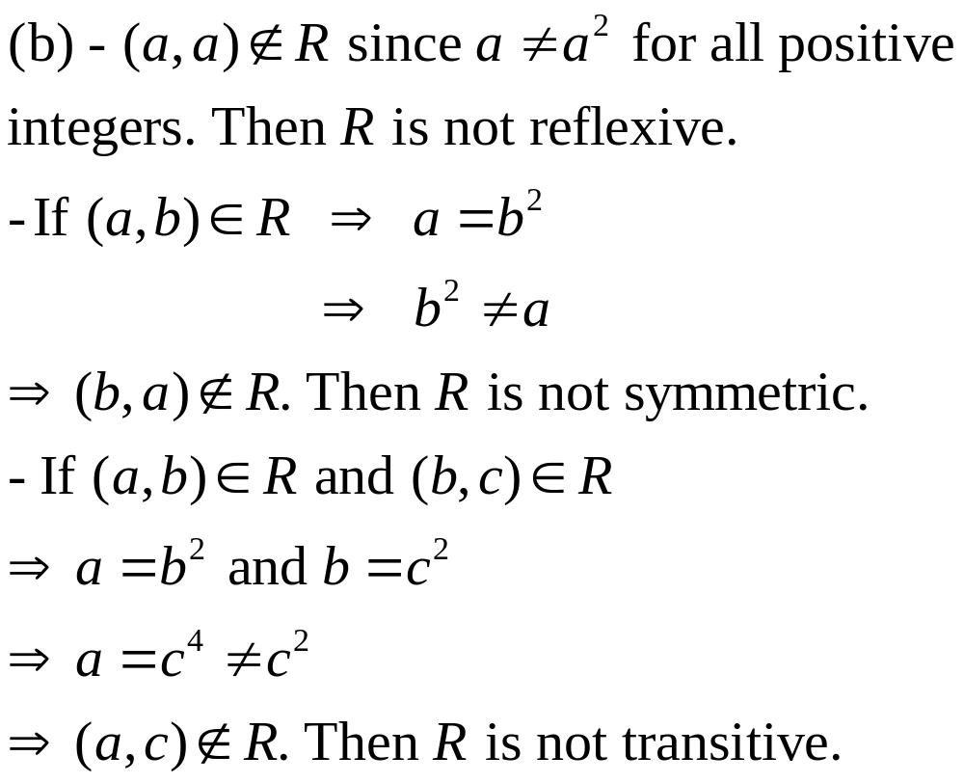

Slide 31
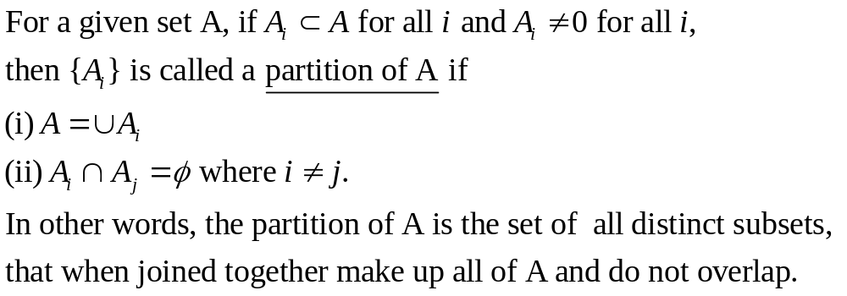
Equivalence Relations & Partitions
An equivalence relation R on a set A is a relation that is reflexive, symmetric and transitive.

Slide 32
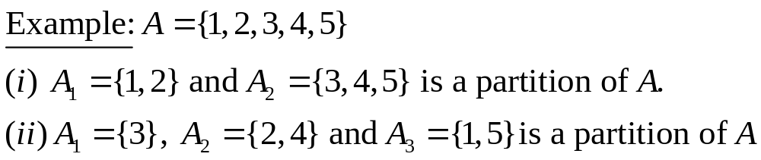
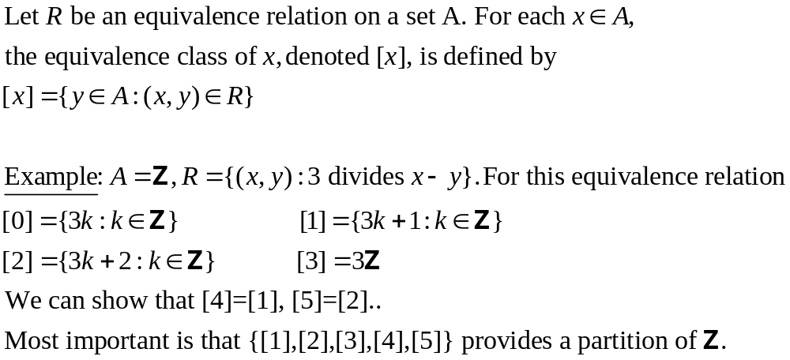
How do partitions come into play with equivalence relations?

Slide 33
Application to databases
Databases have been a staple of business computing from the very beginning of the digital era. In fact, the process of relational databases was born in 1970 (by EM Codd who worked in IBM). Since then, relational databases have grown in popularity to become the standard.
Originally, databases were flat. This means that the information was stored in one long text file, called a tab delimited file. Each entry in the tab delimited file is separated by a special character, such as a vertical bar (|). Each entry contains multiple pieces of information (fields) about a particular object or person grouped together as a record. The text file makes it difficult to search for specific information or to create reports that include only certain fields from each record. Here's an example of the file created by a flat database:
Lname, FName, Age, Salary|Smith, John, 35, $280|Doe, Jane, 28, $325|Brown, Scott, 41, $265|Howard, Shemp, 48, $359|Taylor, Tom, 22, $250

Slide 34
You can see that you have to search sequentially through the entire file to gather related information, such as age or salary. A relational database allows you to easily find specific information. It also allows you to sort based on any field and generate reports that contain only certain fields from each record. Relational databases use tables to store information. The standard fields and records are represented as columns (fields) and rows (records) in a table. Look at this example:
In the relational database example, you can quickly compare salaries and ages because of the arrangement of data in columns. The relational database model takes advantage of this uniformity to build completely new tables out of required information from existing tables. In other words, it uses the relationship of similar data to increase the speed and versatility of the database.
LName | FName | City | Age | Salary
Smith | John | 3 | 35 | $280
Doe | Jane | 1 | 28 | $325
Brown | Scott | 3 | 41 | $265
Howard | Shemp | 4 | 48 | $359
Taylor | Tom | 2 | 22 | $250

Slide 35
The "relational" part of the name comes into play because of mathmatical relations. A typical relational database has anywhere from 10 to more than 1,000 tables. Each table contains a column or columns that other tables can key on to gather information from that table. Look at the table below that matches the number in the City column of the above table with the name of a city.
By storing this information in another table, the database can create a single small table with the locations that can then be used for a variety of purposes by other tables in the database. A typical large database, like the one a big Web site, such as Amazon would have, will contain hundreds or thousands of tables like this all used together to quickly find the exact information needed at any given time.
City # | City Name
1 | Boston
2 | London
3 | New York
4 | Los Angeles

Slide 36
Relational databases are created using a special computer language, structured query language (SQL), that is the standard for database interoperability. SQL is the foundation for all of the popular database applications available today, from Access to Oracle.

Slide 37



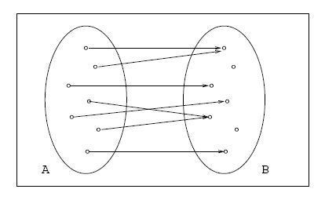
Functions
A function or mapping f from a set A to a set B, denoted
is a correspondence in which to each element of A corresponds exactly one element of B.

Slide 38
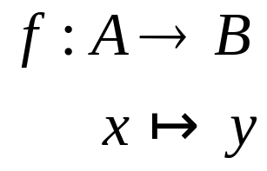

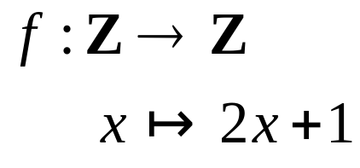
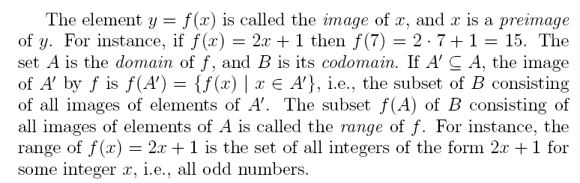
Sometimes we represent the function with a diagram like:
For instance, the following represents the function from Z to Z defined by

Slide 39
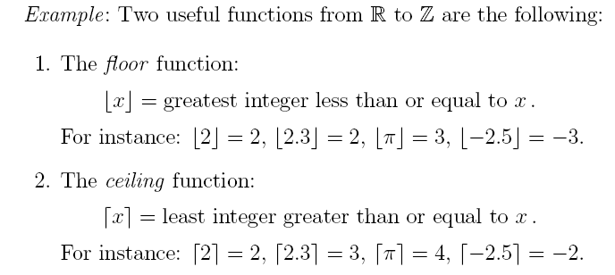

Slide 40
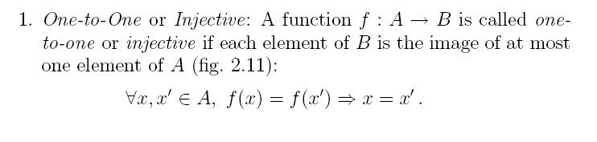
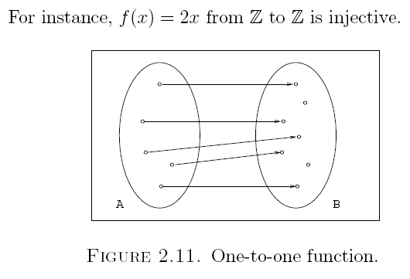
Types of Functions

Slide 41
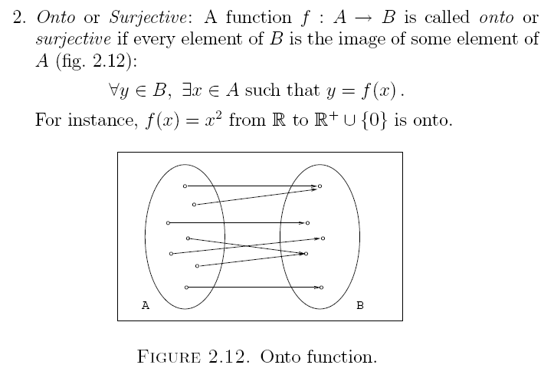

Slide 42

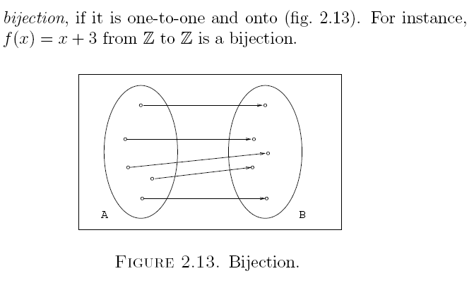

Slide 43
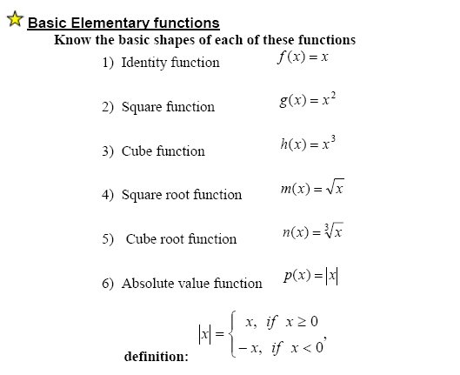
Special Functions

Slide 44
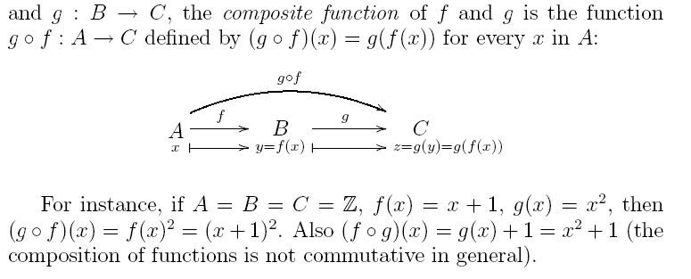
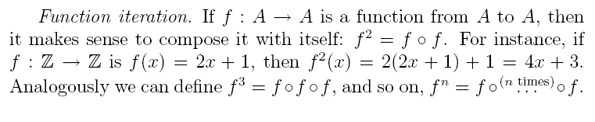
Composition of Functions

Slide 45
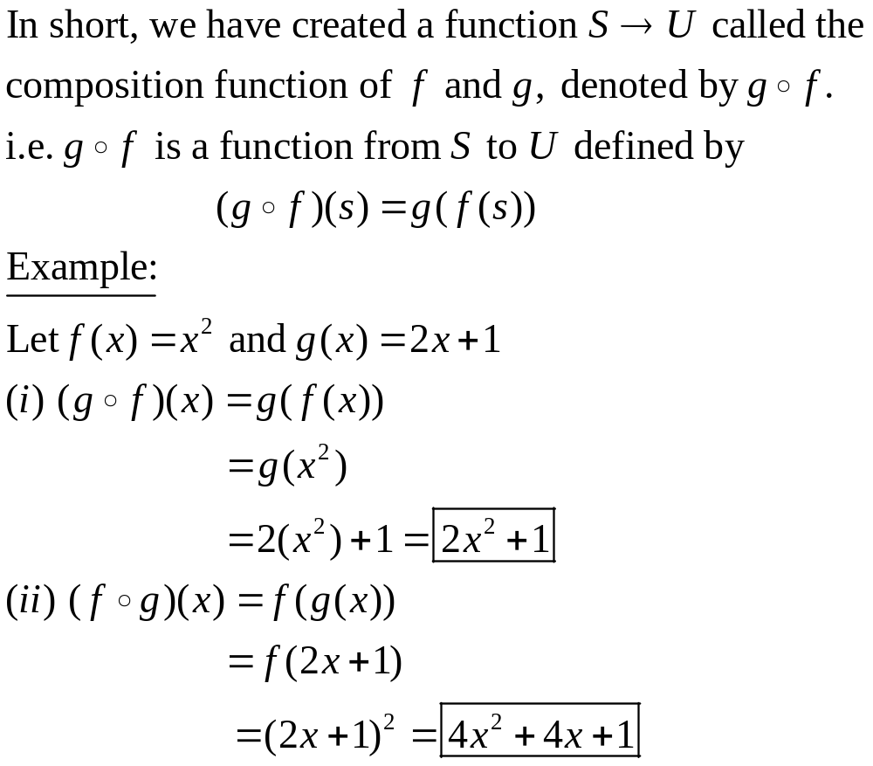

Slide 46


Slide 47

Linear Functions/ ‘Straight Line’ Functions

Slide 48


Slide 49


Quadratic Functions/ ( ) Functions

Slide 50


Slide 51
Arithmetic Operators
Operator | Operator Precedence | Sign
Brackets | B | ()
Division | D | /
Multiplication | M | * or ×
Addition | A | +
Subtraction | S | -

